Slide 1



Garbage Classification with EfficientNetV2B2

Slide 2

Learning Objectives
Understand how to apply transfer learning for image classification.
Explore data preprocessing and augmentation techniques.
Use EfficientNetV2B2 as a feature extractor.
Train a deep learning model using Keras.
Evaluate model performance using accuracy and visual outputs.
GOAL
Source :
www.freepik.com/

Slide 3

Goal
Build an image classification model using transfer learning to automatically categorize garbage into classes like plastic, metal, paper, trash, cardboard and glass to help in automating waste sorting and management.

Slide 4

Tools and Technology used
Dataset Source:
https://www.kaggle.com/datasets/mostafaabla/garbage-classification
Language: Python
Libraries: TensorFlow / Keras, OpenCV, NumPy, Matplotlib
Model: EfficientNetV2B2 (pretrained on ImageNet)
Platform: Google Colab
Data Source: Kaggle

Slide 5
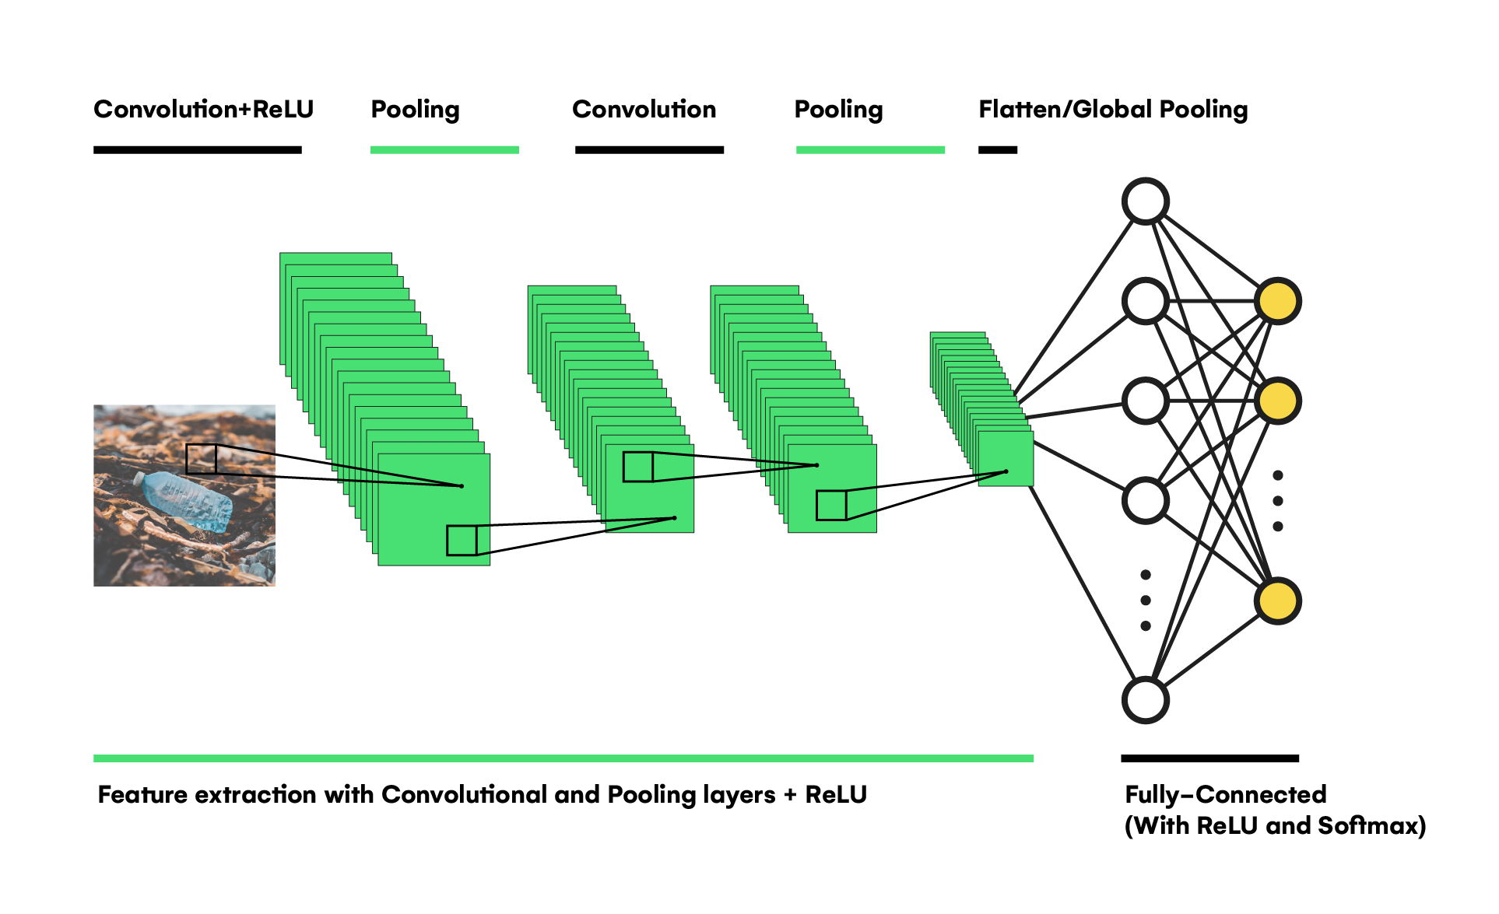
Methodology
Data Loading & Preprocessing
a)Read and resize images (224×224).
b)Assign labels using folder names.
2.Augmentation
a)Rotate, shift, flip, and zoom images.
2.Model Selection
a)Use pretrained EfficientNetV2B2.
4.Model Building
a)Add pooling + dense layers.
5.Training
a)15 epochs, EarlyStopping, Adam optimizer.
6.Evaluation
a)Accuracy, loss, confusion matrix.

Slide 6
1. Data Loading & Preprocessing
Image Reading: Images are loaded using keras.utils.load_img().
Resizing: Each image is resized to 224×224 pixels using target_size.
Conversion: Images are converted to NumPy arrays using img_to_array().
Labeling: Class labels are derived from the folder names.
Shuffling: Data is randomly shuffled to prevent ordering bias.
2. Data Augmentation
Real-time image augmentation using ImageDataGenerator:
Rotation: ±20°
Shift: Width & height shift of 20%
Flip: Horizontal flipping
Zoom: Up to 20%
Pixel values rescaled to [0, 1] for better training.
3. Model Selection
Used EfficientNetV2B2, a lightweight and accurate pretrained model.
Pretrained weights from ImageNet, with include_top=False.

Slide 7
4. Model Building
Added custom top layers:
GlobalAveragePooling2D
Dense(128, activation='relu')
Dense(6, activation='softmax') — for 6-class classification
5. Training
Optimizer: Adam, learning rate = 0.0001
Loss: Sparse Categorical Crossentropy
Epochs: Up to 15
Used EarlyStopping to avoid overfitting by monitoring validation loss.
6. Evaluation
Performance evaluated using:
Training vs Validation Accuracy
Confusion Matrix
Final Accuracy Score on test data

Slide 8
Problem Statement:
In this project, we aim to develop a sophisticated garbage classification system leveraging the EfficientNetV2B2 architecture.
Our primary dataset serves as a foundation for building models that can eventually automate waste segregation, a critical step in optimizing recycling and waste management, ultimately aiding in environmental conservation.

Slide 9
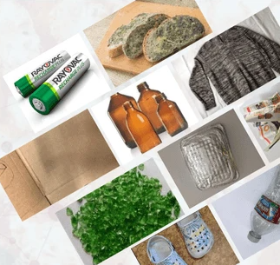
Sorting waste manually is inefficient and error-prone.
An AI-driven model to classify waste images can significantly assist smart recycling systems and reduce human effort.

Slide 10
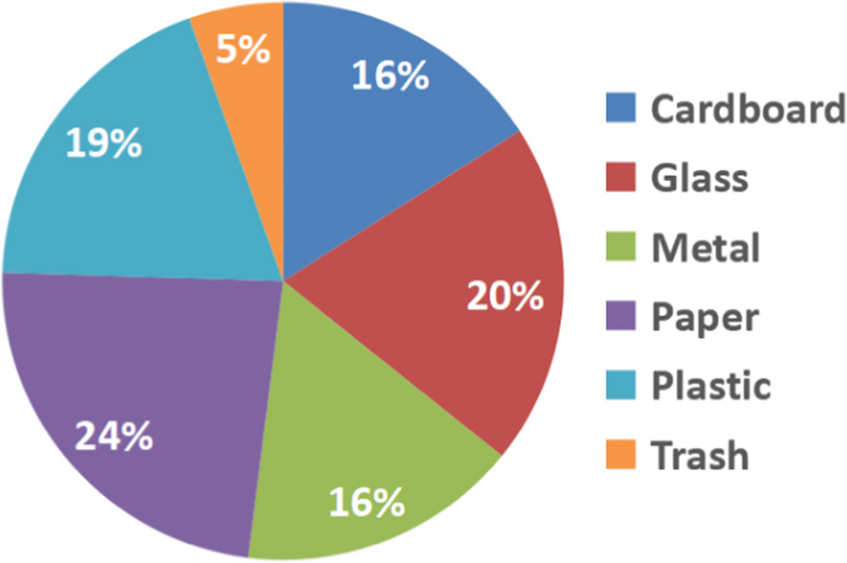
Solution:
I trained a deep learning image classifier using transfer learning with EfficientNetV2B2.
The model classifies garbage into categories like cardboard, glass, metal,plastic, paper and trash with good accuracy.

Slide 11
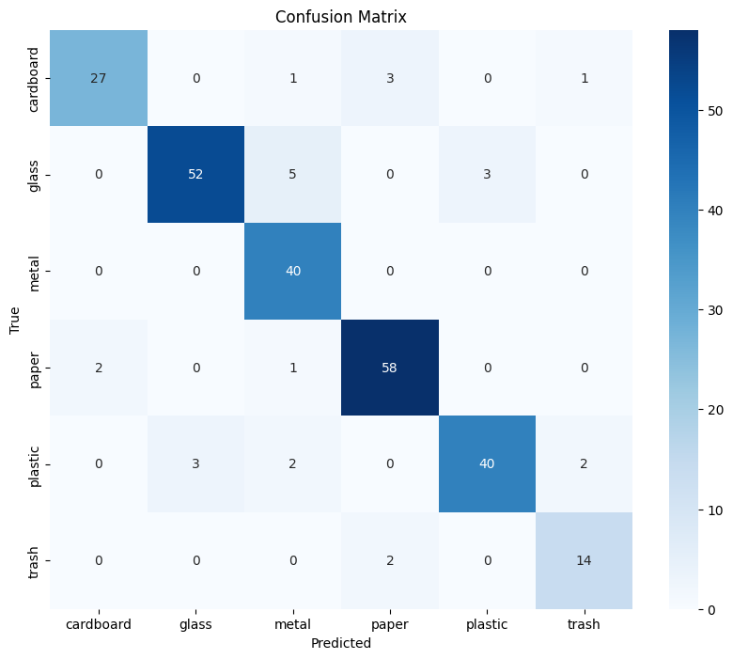
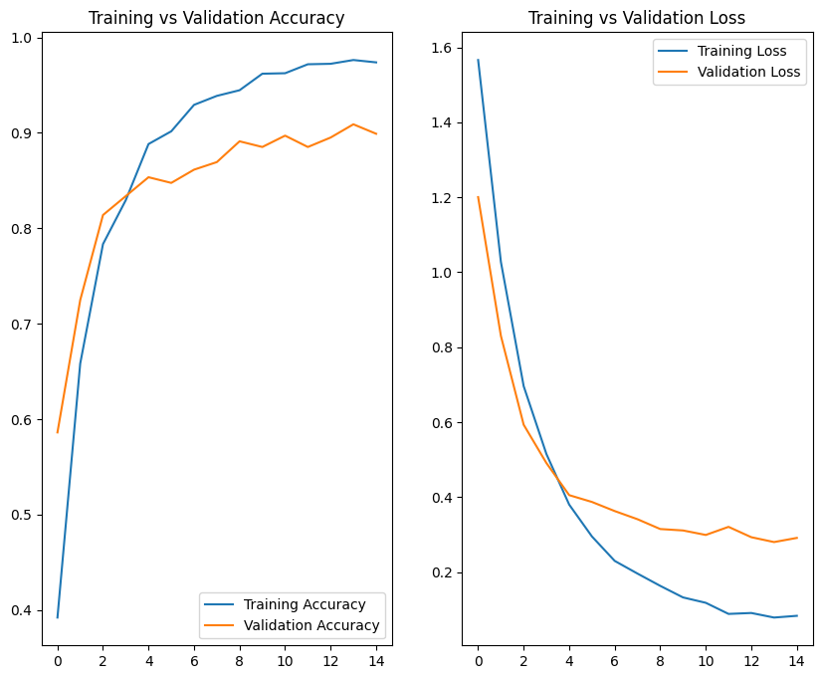
Screenshot of Output:

Slide 12
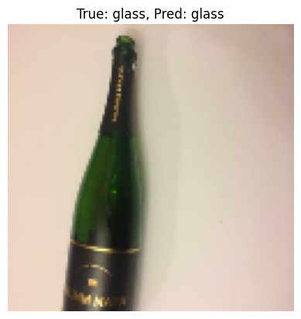
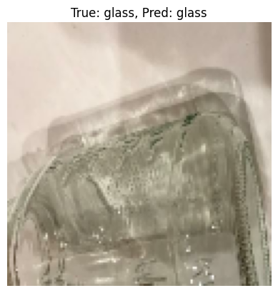
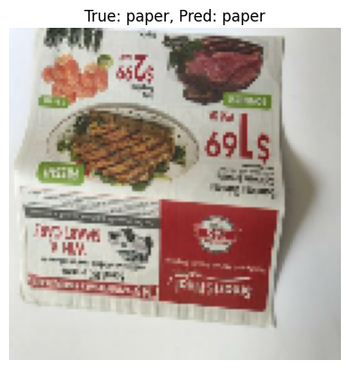
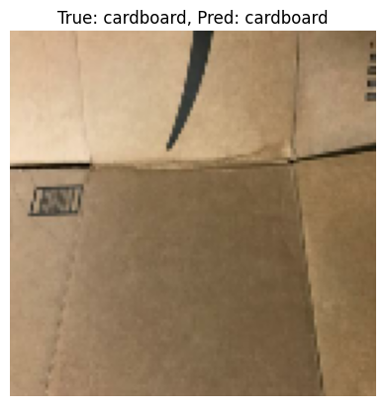
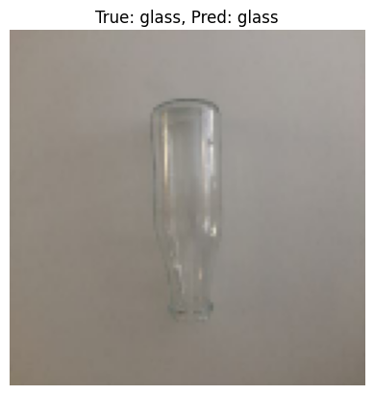
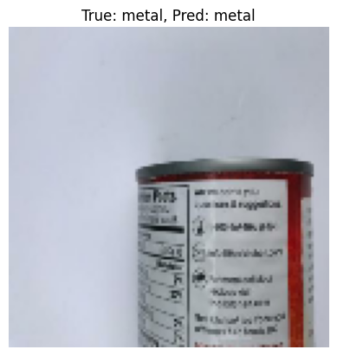

Slide 13
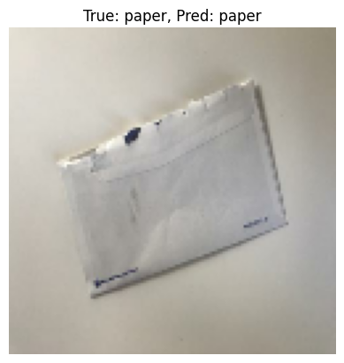
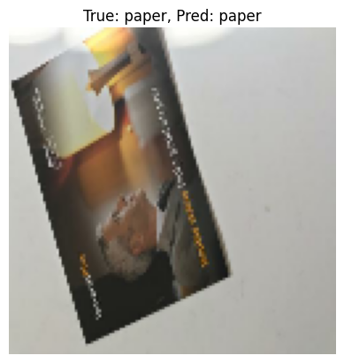

Slide 14
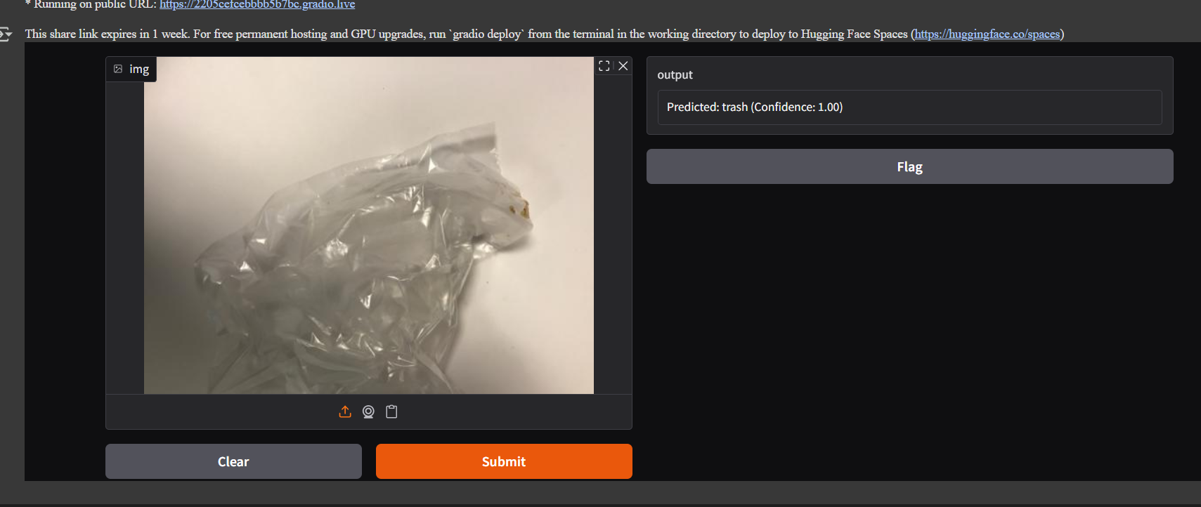

Slide 15
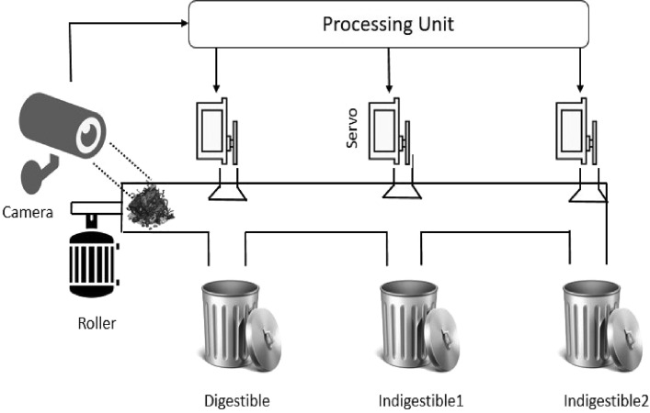
Conclusion:
The project successfully demonstrates the use of transfer learning for garbage classification.
Model achieved good accuracy with minimal training.
Can be extended into real-world waste sorting systems.

